Slide 1

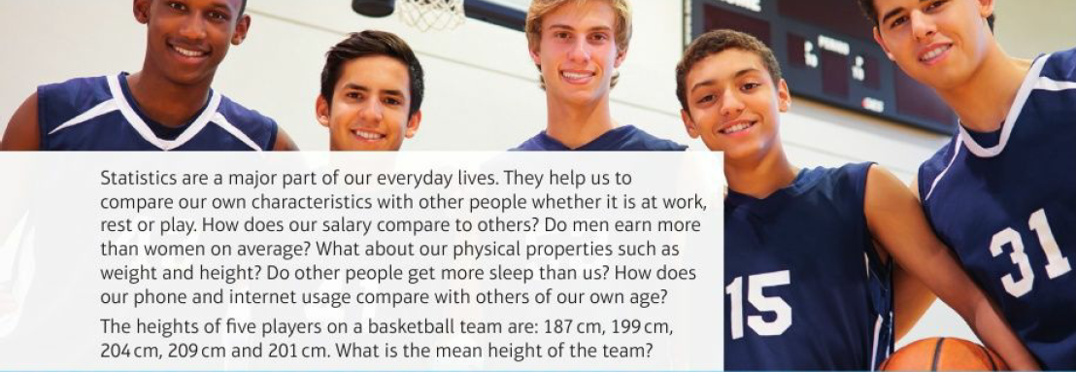
Mathematics (9-1) - iGCSE
2018-20
Year 07
Statistics are a major part of our everyday lives. They help us to compare our own characteristics with other people whether it is at work, rest or play. How does our salary compare to others? Do men earn more than women on average? What about our physical properties such as weight and height? Do other people get more sleep than us? How does our phone and internet usage compare with others of our own age?
The heights of five players on a basketball team are: 187 cm, 199 cm, 204cm, 209 cm and 201cm. What is the mean height of the team?
Unit 3 – Interpreting and Representing Data

Slide 2
Contents
Page iv
3 Interpreting and representing data 61
Prior knowledge check 30
3.1 Statistical diagrams 1
3.2 Time series 67
3.3 Scatter graphs 70
3.4 Line of best fit 72
3.5 Averages and range 75
3.6 Statistical diagrams 2 78
Problem-solving: Pollution particulates 81
Checkup 82
Strengthen 84
Extend 89
Knowledge check 94
Unit Test 94

Slide 3
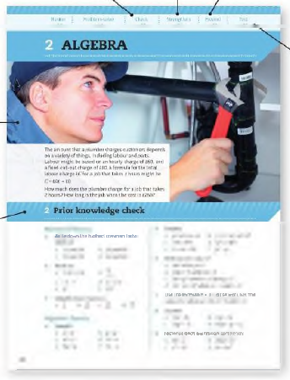
Contents
Page v
At the end of the Master lessons, take a check-up test to help you to decide whether to strengthen or Extend our learning
Extend helps you to apply the maths you know to some different situations
Unit Openers put the maths you are about to learn into a real-life context. Have a go at the question - it uses maths you have already learnt so you should be able to answer it at the start of the unit.
When you have finished the whole unit, a Unit test helps you see how much progress you are making.
Choose only the topics in strengthen thay you need a bit more practice with. You’ll find more hints here to lead you through specific questions. Then move on to Extend
Use the Prior knowledge check to make sure you are ready to start the main lessons in the unit. It checks your knowledge from Key Stage 3 and from earlier in the GCSE course. Your teacher has access to worksheets if you need to recap anything.

Slide 4
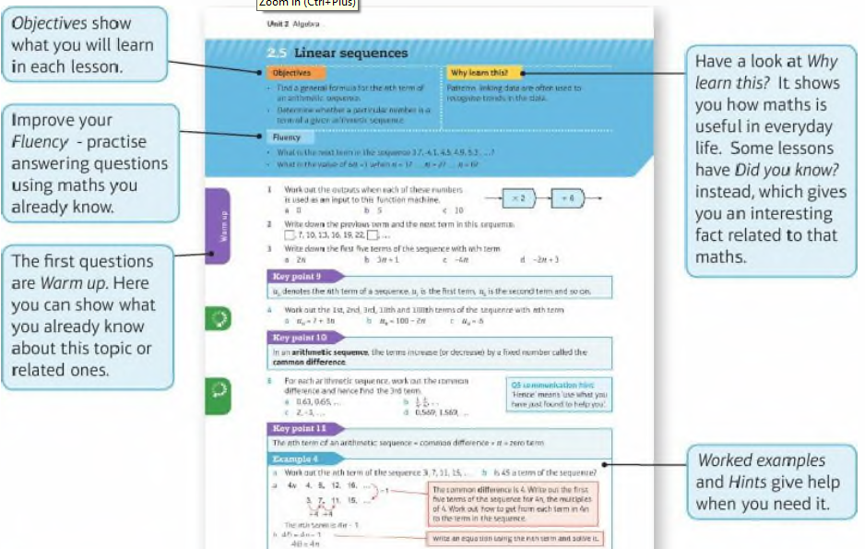
Contents
Page vi

Slide 5
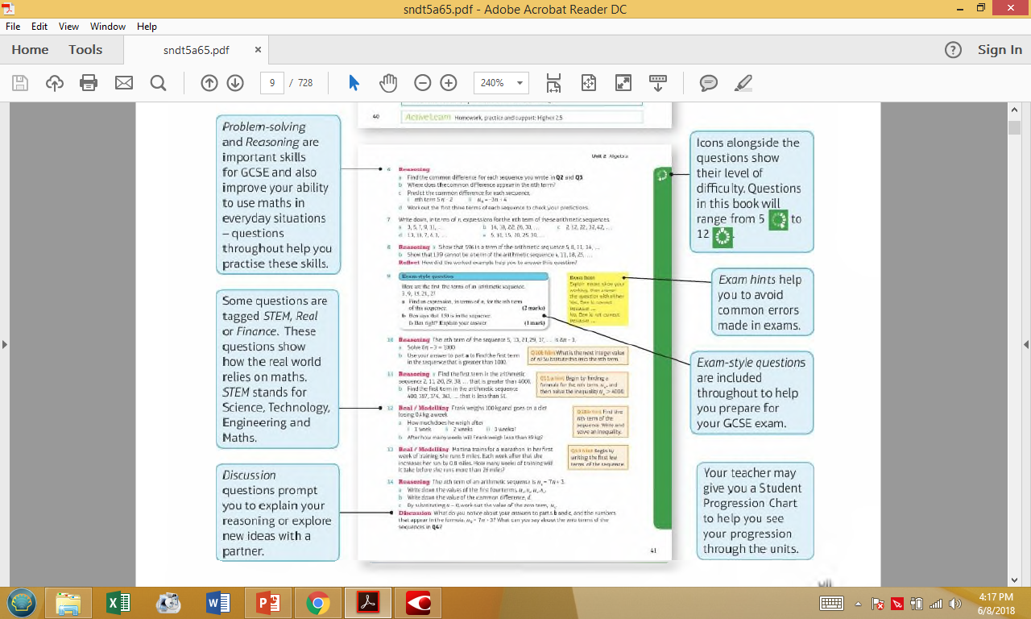
Contents
Page vi

Slide 6
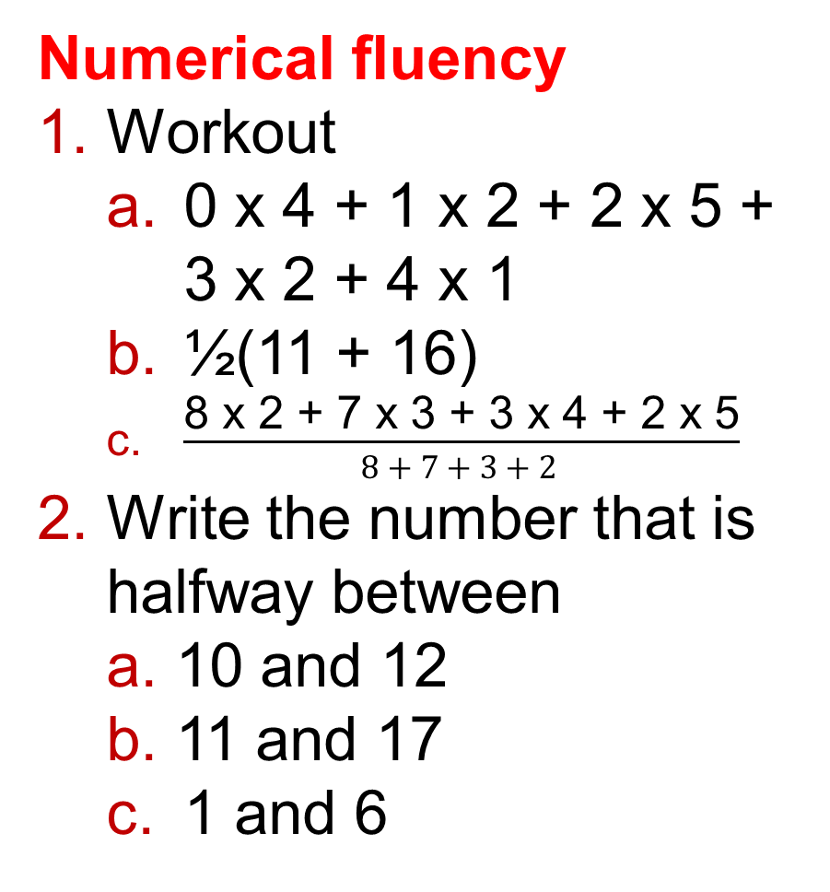
3 – Prior Knowledge Check
Page 61
Numerical fluency
Workout
  0 x 4 + 1 x 2 + 2 x 5 + 3 x 2 + 4 x 1
  ½(11 + 16)
  $\frac{\text{8 }\text{x}\text{ 2 + 7 }\text{x}\text{ 3 + 3 }\text{x}\text{ 4 + 2 }\text{x}\text{ 5}}{8 + 7 + 3 + 2 }$
Write the number that is halfway between
  10 and 12
  11 and 17
  1 and 6

Slide 7
3 – Prior Knowledge Check
Page 61
Fluency with Data
The table shows the times of trains from York to London.
  How long does the 09:30 train take to get to London? Give your answer in hours and minutes.
  What time does the 14:06 train arrive in London? Give your answer as an am/pm time.
  Mary arrives at York station at 9:20 a m. Which train does she catch to London?
Train | A | B | C | D
Depart | 09:30 | 10:01 | 10:59 | 14:06
Arrive | 11:42 | 12:23 | 12:51 | 18:11

Slide 8
3 – Prior Knowledge Check
Page 61
Find the mean, median, mode and range of these data sets.
  0, 1, 1, 3, 5
  1, 3, 3, 3, 5, 7, 8, 13
  5, 0, 1, 6, 5, 4, 1
The table shows the age distribution of men and women in a company.
Draw a compound bar chart to show this information.
Age | 18-24 | 25-39 | 40-69
Number of Men | 10 | 40 | 50
Number of Women | 20 | 50 | 30

Slide 9
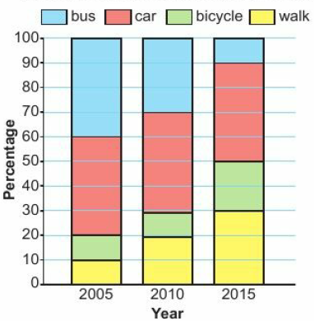
3 – Prior Knowledge Check
Page 61
In 2005, a group of office workers were asked how they travelled to work. The survey was repeated in 2010 and 2015.
The compound bar chart shows the results.
  What percentage of workers walked to work in 2005?
  What percentage of workers cycled to work in 2015?
  For each statement write T if it is definitely true, F if it is definitely false or CT if you cannot tell because there is not enough information.
    The number of workers walking to work increased in every survey between 2005 and 2015.
    The proportion of workers travelling by bus decreased in every survey between 2005 and 2015.
    The number of workers travelling to work by car in 2010 was the same as the number cycling or travelling by bus combined.

Slide 10
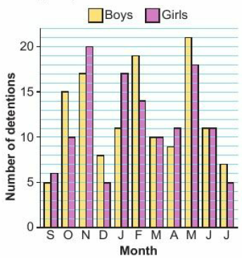
3 – Prior Knowledge Check
Page 62
The dual bar chart shows the number of school detentions given to boys and girls during the year.
  How many detentions were given to boys in March?
  How many more detentions were given to boys than to girls in October?
  In which months did boys and girls get the same number of detentions?
  In which month did girls get 6 more detentions than boys?
  In which month did the school give the largest number of detentions?
  Compare the total number of detentions given to boys and girls.

Slide 11
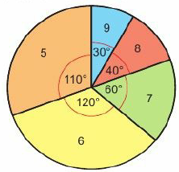
3 – Prior Knowledge Check
Page 62
The table shows the marks that two students obtained in their end of year exam. Draw a dual bar chart to show this information.
The pie chart shows the GCSE grades awarded to 720 students.
  What is the
  modal grade?
  How many
  students were
  awarded grade
  8?
Subject | Geography | Biology | Spanish
Kyle | 9 | 10 | 5
Adil | 3 | 10 | 2

Slide 12
3 – Prior Knowledge Check
Page 62
The table shows the holiday destinations of 120 people. Draw a pie chart for this data.
The bar chart shows the scores obtained when a dice is rolled.
  How many times did the dice land on a 2?
  Work out the
  total number
  of rolls.
  What is the
  modal score?
Destination | UK | France | USA | Spain
No. of People | 55 | 15 | 20 | 30

Slide 13
3 – Prior Knowledge Check
Page 63
A social scientist is studying urban life in a developing country. She uses a data collection sheet to record information about the size of families living in a city.
  Work out the range of the number of children per family in the city,
No. of Children | Tally
0 | ||||
1 | |||| ||||
2 | |||| |||
3 | |||| |
4 | ||||
5 | ||
  Work out the total number of families in the survey.
  Calculate the mean. Round your answer to 1 decimal place (1 d.p.).
  The mean number of children per family in a rural community is 3.1. Compare this with the mean for city families.

Slide 14
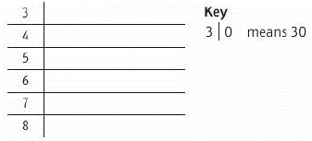
3 – Prior Knowledge Check
Page 63
The data set shows points awarded in the 2013/14 season of the Premier League.
69, 86, 36, 33, 40, 38, 84, 37, 72, 45, 49, 50, 56, 64, 30, 42, 79, 82, 38, 32
  Display the data on a stem and leaf diagram.
  How many teams are in the Premier League?
  How many of these teams scored over 72 points?

Slide 15
3 – Prior Knowledge Check
Page 63
Vinay conducts a survey to find out the types of TV programs people like to watch.
He asks people whether they like to watch sport, drama, news or documentaries. Design a suitable data collection sheet Vinay could use to collect the information.
The heights, in centimetres, of a dozen students in Year 10 are
162, 154, 174, 165, 175, 149, 160, 167, 171, 159, 170, 163
  Is the data discrete or
  continuous?
  Work out the missing
  numbers, x and y, in the
  grouped frequency table.
  Draw a frequency
  diagram.
Height h (cm) | Frequency
140 ≤ h < 150 | 1
150 ≤ h < 160 | 2
160 ≤ h < 170 | x
170 ≤ h < 180 | y

Slide 16
3 – Prior Knowledge Check
Page 63
* Challenge
Find a set of five positive whole numbers with
  range 10
  mode 4
  median 6
  mean 7.
  Is there more than one possible set? Repeat for a set of six numbers. Find as many possible answers as you can.

Slide 17
3.1 – Statistical Diagrams 1
Page 63
Objectives |  | Why Learn This
Construct and use back-to-back stem and leaf diagrams. Construct and use frequency polygons and pie charts. |  | Diagrams provide a quick way of comparing the salaries of men and women.
Fluency
What are the mode, median and range of 2, 2, 4, 7?
ActiveLearn - Homework, practice and support: Higher 3.1

Slide 18
3.1 – Statistical Diagrams 1
Page 64
* Challenge
The table shows the median and range of scores obtained by Sophie and Celia after playing many rounds of golf.
Write two sentences comparing the performances of Sophie and Celia.
Warm Up
 | Median | Range
Sophie | 71 | 13
Celia | 93 | 25
Q1 strategy hint - Compare the median scores and range of scores. In golf a lower score is better.

Slide 19

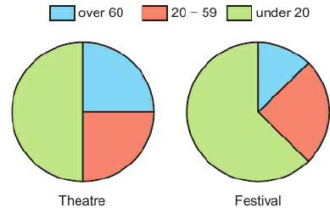
3.1 – Statistical Diagrams 1
Page 64
Real / Communication The pie charts show the ages of people attending an open air theatre and a music festival.
1500 attended the theatre and 20000 attended the festival.
  How many people under 20 attended the theatre?
  Which pie chart has the larger sector for over-60s?
  Show that there are more over-60s at the festival than at the theatre.
  Discussion Does a larger sector always represent a larger number?
Q2b hint – What fraction is the over-60 sector?

Slide 20

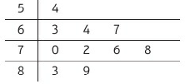
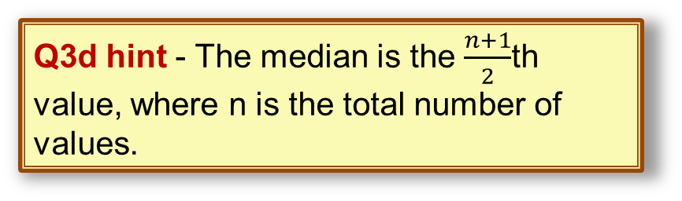
3.1 – Statistical Diagrams 1
Page 64
Reasoning The stem and leaf diagram shows the masses
of a group of people in a lift.
  How many people are in the lift?
  What is the mass of the heaviest person in the lift?
  What is the range?
  What is the median?
  A safety notice in the lift reads,
  'Maximum 12 persons, total
  weight 800 kg’.
  Explain whether this group of
  people can travel in the lift
  safely.
  Calculate the mean mass of the people in the lift.
Key: 5 | 4 means 54 kg.
Q3d hint - The median is the $\frac{n+1}{2}$th value, where n is the total number of values.
Q3c strategy hint - Mention both of the facts on the safety notice in your answer.

Slide 21
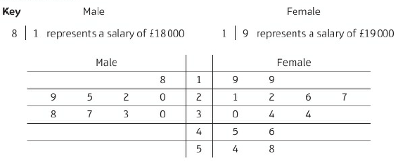
3.1 – Statistical Diagrams 1
Page 63
Key Point 1
A back-to-back stem and leaf diagram compares two sets of results.
Example 1
The annual salaries of employees working in an ICT company are displayed in the back-to-back stem and leaf diagram.
Compare the distribution of salaries of the male and female employees.

Slide 22
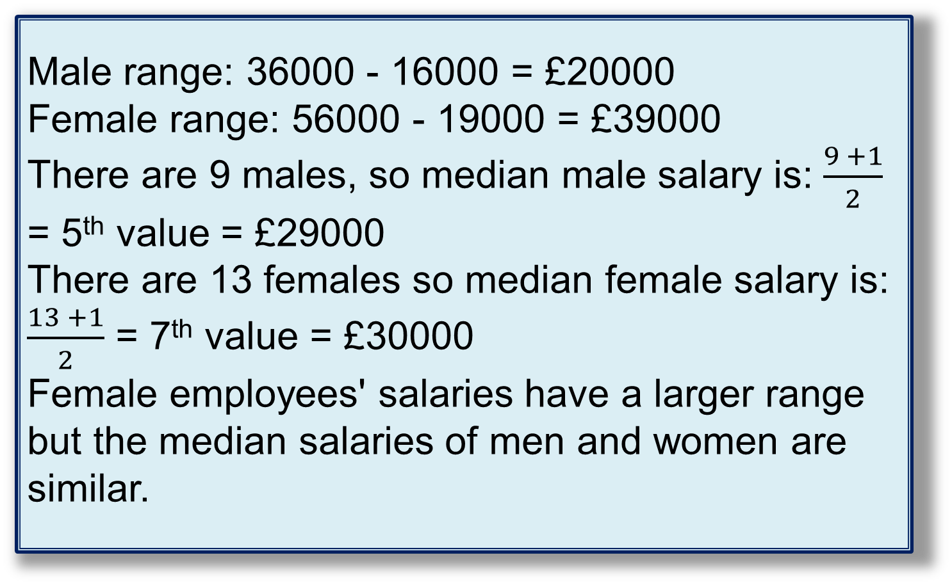
3.1 – Statistical Diagrams 1
Page 63
Example 1
Male range: 36000 - 16000 = £20000
Female range: 56000 - 19000 = £39000
There are 9 males, so median male salary is: $\frac{9 +1}{2}$ = 5th value = £29000
There are 13 females so median female salary is:
$\frac{13 +1}{2}$ = 7th value = £30000
Female employees' salaries have a larger range but the median salaries of men and women are similar.
Write a sentence comparing ranges and medians.

Slide 23
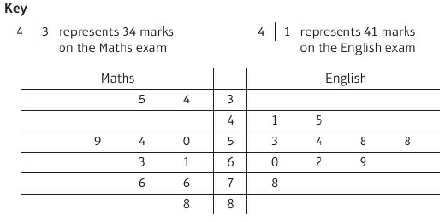
3.1 – Statistical Diagrams 1
Page 64
Real / Problem-solving A group of students take maths and English exams. The back-to-back stem and leaf diagram
shows their results.
Compare the distribution of marks obtained by the
students for the two exams.
Discussion What does the shape of a back-to-back stem and leaf diagram show you?
Q4 hint - Refer to the context (exam marks) in your comparison.

Slide 24
3.1 – Statistical Diagrams 1
Page 66
Real / Problem-solving The heights (in cm, measured to the nearest cm) of two types of tulips are recorded.
Type A: 24,37,52, 26, 29, 46,47,29,30, 36, 48,55, 59
Type B: 16, 23, 34, 37, 31, 13, 64, 52, 53, 37, 43, 39, 38, 42, 42, 37
  Draw a back-to-back stem and leaf diagram for this data,
  Use the shape of your diagram to compare the distribution of heights of the two types of tulip.
Q5b hint - A stem and leaf diagram is similar to a bar chart turned on its side. Compare the outlines of the two charts.

Slide 25
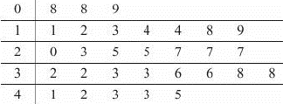

3.1 – Statistical Diagrams 1
Page 66
6 – Exam-Style Questions
Jeevan counted the number of letters in each sentence of a newspaper article. He showed his results in a stem and leaf diagram.
Write down the number of sentences with 36 letters.
Work out the range.
What is the modal
number of letters?
Work out the
median. (4 marks)
Exam hint
Find the total number of values to help you find the median value.

Slide 26

3.1 – Statistical Diagrams 1
Page 66
Key Point 2
To draw a frequency polygon you can join the midpoints of the tops of the bars in a frequency diagram, with straight lines
The table shows the heights of 100 students.
  Copy and complete the frequency diagram.
  Draw a frequency polygon on the same diagram.
  Discussion Is there a quicker way to draw a frequency polygon without drawing a frequency diagram first?
Q7a hint – Data is continuous, so no gaps between bars.
Q7b hint – Draw straight lines to connect the midpoint of the tops of the bars.

Slide 27
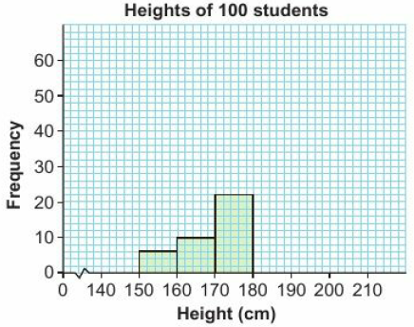
3.1 – Statistical Diagrams 1
Page 66
Height h (cm) | Frequency
140 ≤ h < 150 | 0
150 ≤ h < 160 | 6
160 ≤ h < 170 | 10
170 ≤ h < 180 | 22
180 ≤ h < 190 | 52
190 ≤ h < 200 | 10
290 ≤ h < 210 | 0
Q7a hint – Data is continuous, so no gaps between bars.

Slide 28
3.1 – Statistical Diagrams 1
Page 67
Key Point 3
To draw a frequency polygon, plot the frequency against the midpoints for each group.
Real The frequency table shows the time taken for competitors to complete a charity fun run.
  How many runners took part?
  Work out the percentage of runners who took more than 100 minutes,
  Estimate the range.
  Copy and complete the frequency polygon.
  Discussion Why is your answer to part c only an estimate? What assumptions did you make?
Q8c hint – Do we know the actual times for the 4 runners in the 20 ≤ t < 40 group? What is the shortest time taken?
Q8d hint – Work out the midpoint for each group.

Slide 29
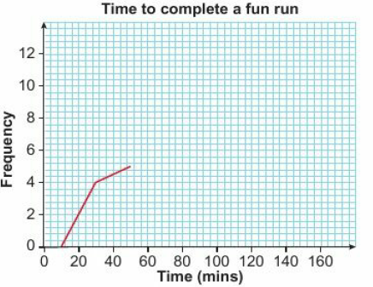
3.1 – Statistical Diagrams 1
Page 66
Time t (mins) | Frequency
20 ≤ t < 40 | 4
40 ≤ t < 60 | 5
60 ≤ t < 80 | 12
80 ≤ t < 100 | 9
100 ≤ t < 120 | 7
120 ≤ t < 240 | 3
Q8d hint – Work out the midpoint for each group.

Slide 30
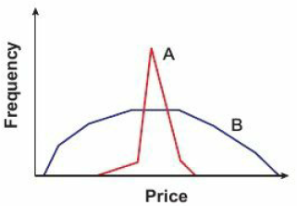
3.1 – Statistical Diagrams 1
Page 67
Reasoning A group of Year 10 students are each asked to guess the price of a can of cola and a small bunch of bananas.
The results are displayed on the frequency polygons.
  Which data set has the greater range?
  Would you expect the median of data set A to be greater than, less than or about the same as the median of data set B?
  Which data
  set do you
  think gives
  the prices
  for cola?

Slide 31
3.2 – Time Series
Page 67
Objectives |  | Why Learn This
Plot and interpret time series graphs. Use trends to predict what might happen in the future. |  | Scientists can use trends in weather patterns to investigate climate change.
Fluency
Is this sequence increasing or decreasing? 1, 5, 9, 13, 17, 21, 25, 29
ActiveLearn - Homework, practice and support: Higher 3.2

Slide 32
3.2 – Time Series
Page 68
Match each sequence with the correct description.
Predict the next two terms in these sequences.
  4, 6, 8, 4, 6, 8, 4, 6, 8, ... b. 3, 4, 6, 9, 13, 18, 24, 31, ...
The price of a book rises from £16 to £20. Work out the percentage increase.
Warm Up
3, 5, 7, 9, 11, 13, 15, 17, 19, 21 | The values are constant.
0, 26, 46, 60, 69, 76, 81, 84, 85, 85 | The values increase at a constant rate.
4, 4, 4, 4, 4, 4, 4, 4, 4, 4 | The values decrease at a constant rate.
12,11,10, 9, 8, 7, 6, 5, 4, 3 | The values increase at a decreasing rate.
1, 3, 7, 2, 0, 4, 8, 6, 2, 5 | The values fluctuate up and down

Slide 33
3.2 – Time Series
Page 68
Key Point 4
A time series graph is a line graph with time plotted on the horizontal axis.
Real/ Reasoning The table shows the temperature of a hospital patient recorded on the hour every 2 hours during a 24-hour period.
  What is the patient's temperature at 6 pm?
  What is the patient's maximum temperature
  during this period? At what time did it occur?
  Work out the mean temperature. Give your
  answer to 1 decimal place (1 d.p.).
  Discussion Why is the mean temperature an estimate?
  Represent this time series on a line graph. Comment on the variation of temperature.
Time | 00 | 02 | 04 | 06 | 08 | 10 | 12 | 14 | 16 | 18 | 20 | 22
Temp. (⁰c) | 36.7 | 36.8 | 37.1 | 37.4 | 37.8 | 38.3 | 38.0 | 38.2 | 37.4 | 37.3 | 37.2 | 37.1
Q4 hint - Use a vertical axis from 36 to 39.

Slide 34
3.2 – Time Series
Page 68
Each week of the autumn term, a teacher records the number of pieces of late homework.
Draw a time series graph for this data. Comment on how late homework varies during the course of the term.
Week | 1 | 2 | 3 | 4 | 5 | 6 | 7 | 8 | 9 | 10 | 11 | 12
No. of late homeworks | 38 | 34 | 26 | 14 | 8 | 7 | 18 | 10 | 7 | 15 | 25 | 40

Slide 35
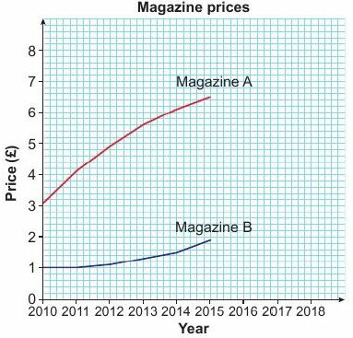
3.2 – Time Series
Page 68
Real / Reasoning The time series graph shows the prices of two magazines over the last 6 years,
  What was the price of Magazine A in 2012?
  Suzy says the price of Magazine A has risen more than the price of Magazine B during this period.
  Is she correct? Give a reason for your answer.
  Suzy also says that the rate of increase in the price of Magazine A is slowing down.
  Is she correct? Give a reason for your answer.
  Predict the prices of each magazine in 2018.

Slide 36
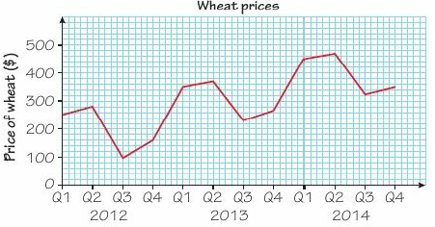
3.2 – Time Series
Page 69
Example 2
The table shows the
quarterly price of a ton
of wheat (in dollars)
during the last three
years.
What is the price in the third quarter (Q3) of 2013?
In which quarter is the price the lowest?
Draw a time series graph of the data.
Describe the variation in prices during this
period and comment on the overall trend.
$230
The lowest price is $ 101 which
occurs in the third quarter of 2012.
The price of wheat fluctuates up and down
during the course of each year.
However the overall trend shows a general increase in prices.
2012 |  |  |  | 2013 |  |  |  | 2014
Q1 | Q2 | Q3 | Q4 | Q1 | Q2 | Q3 | Q4 | Q1 | Q2 | Q3 | Q4
38 | 34 | 26 | 14 | 8 | 7 | 18 | 10 | 7 | 15 | 25 | 40
Communication hint - Prices are recorded every 3 months so the first quarter covers January, February and March.

Slide 37
3.2 – Time Series
Page 69
Real / Problem-solving The table shows the quarterly sales (in thousands) of umbrellas during the last three years.
  What are the sales in the second quarter of 2013?
  In which quarter are sales the highest?
  Draw a time series graph for this data.
  Describe the variation in umbrella sales during
  this period and comment on the overall trend,
  Reflect What do you think the term 'trend‘ means? Write a definition in your own words.
2012 |  |  |  | 2013 |  |  |  | 2014
Q1 | Q2 | Q3 | Q4 | Q1 | Q2 | Q3 | Q4 | Q1 | Q2 | Q3 | Q4
89 | 75 | 24 | 85 | 80 | 66 | 19 | 76 | 75 | 62 | 17 | 73
Q7a hint – Sales are in thousands

Slide 38
3.2 – Time Series
Page 69
Real / Problem-solving The table shows the profit (in millions of pounds) of an ICT company over the past
10 years. The profit for 2010 is not known.
  Draw a line graph for this time series.
  Describe the overall trend.
  Estimate what the profit might have been in 2010.
  Predict what the profit might be in 2015.
  Discussion How reliable are your values in parts c and d?
Year | 2005 | 2006 | 2007 | 2008 | 2009 | 2010 | 2011 | 2012 | 2013 | 2014
Profit | 0.5 | 0.7 | 0.8 | 1.1 | 1.4 | ? | 2.4 | 3.1 | 4.1 | 5.3
Q8a hint – Draw a horizontal axis from 2005 to 2015 and a vertical axis up to 7, to help with part d.
Q8b hint – Continue the 'curved' shape of the graph for two more years. Profit is in millions of pounds.

Slide 39
3.2 – Time Series
Page 70
9 – Exam-Style Questions
The table shows the height of sea water in a harbour between midnight and noon.
Draw a time series graph to show how water height varies
At what time does high tide occur in the morning?
Predict the height at 3 pm.
It is only safe for a ship to enter the harbour when the water height exceeds 7.5 m.
During which times of the day is it not safe for ships to enter the harbour? (7 marks)
Time | 0am | 1am | 2am | 3am | 4am | 5am | 6am | 7am | 8am | 9am | 10am | 11am | Noon
Height (m) | 10 | 12.5 | 14.3 | 15 | 14.3 | 12.5 | 10 | 7.5 | 5.7 | 5 | 5.7 | 7.5 | 10
Exam hint
Use both the table and the graph to help you spot the pattern.

Slide 40
3.3 – Scatter Graphs
Page 70
Objectives |  | Why Learn This
Plot and interpret scatter graphs. Determine whether or not there is a linear relationship between two variables. |  | Scatter graphs help us to see whether there is a connection between two sets of data. For example, it would be useful for a shop to know if there is a link between sales of bottled water and temperature.
Fluency
State whether each line has a positive, negative or zero gradient.
A B C

Slide 41
3.3 – Scatter Graphs
Page 70
Draw x and y-axes on graph paper from 0 to 8. Plot five points with coordinates
A(2, 4.75), B(5, 3.5), C(4, 3.75), D(7, 3) and E(3, 4).
Four of the points lie on a line. Which point does not lie on the line?
Warm Up
Key Point 5
Bivariate data has two variables. Plotting these on a scatter graph can show whether there is a relationship between them.

Slide 42
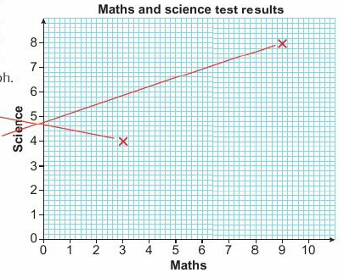
3.3 – Scatter Graphs
Page 70
Eight students took a maths test and a science test. Their marks are displayed in the table.
Student | A | B | C | D | E | F | G | H
Maths Mark | 3 | 9 | 7 | 3 | 6 | 10 | 5 | 1
Science Mark | 4 | 8 | 4 | 2 | 5 | 7 | 3 | 1
  Copy and complete the scatter graph.
  Student A scored 3 in maths and 4 in science so draw a cross at (3,4).
  For student B, draw a cross at (9, 8)
  Use the scatter graph to copy and complete the sentence.
  In general, students with higher maths scores got _________ science scores and students with Lower maths scores got ___________ science scores.
ActiveLearn - Homework, practice and support: Higher 3.3

Slide 43
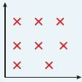
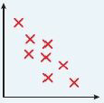
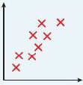
3.3 – Scatter Graphs
Page 71
Key Point 6
A scatter graph shows a relationship or correlation between variables.
No (or zero)
correlation
No linear relationship between x and y.
Negative correlation
Points lie close to a downward-sloping straight line. As x increases y decreases.
Positive correlation
Points lie close to an upward-sloping straight line. As x increases y
increases.

Slide 44
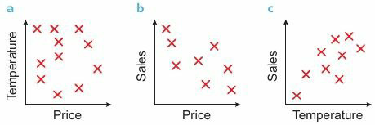
3.3 – Scatter Graphs
Page 71
The daily sales and price of ice cream are recorded together with the maximum outside temperature. Three scatter graphs are plotted from the data.
For each graph state whether there is positive, negative or no correlation and describe in words what this means.
Q3 hint - To describe what the correlation means in words, you could say, 'As the price of ice creams increase, sales

Slide 45
3.3 – Scatter Graphs
Page 71
Real A car dealer notes the engine size of seven models of car and the distance they travel on a litre of petrol.
  Draw a scatter graph for this data,
  Describe any relationship between these two variables.
Engine Size (litres) | 1 | 1.4 | 1.6 | 2 | 3 | 3.5 | 4
Distance (km) | 16 | 14.2 | 13.5 | 11.7 | 9.2 | 8.4 | 7.1
Q4a hint - Put engine size on the horizontal axis from 0 to 5 and distance on the vertical axis from 6 to 17.
Q4a hint - State the type of correlation and then write a sentence beginning, 'The larger the engine size, the ....'

Slide 46
3.3 – Scatter Graphs
Page 71
An auction house asks an art dealer to award six paintings marks out of 10, without disclosing the names of the artists.
The market value (in £100 000s) and dealer's score for each painting are in the table.
Draw a scatter graph and describe any relationship between the score and the value of the paintings.
Score | 2 | 7 | 5 | 3 | 8 | 4
Market Value | 3.5 | 1.8 | 5.6 | 4.3 | 8.4 | 2.5

Slide 47
3.3 – Scatter Graphs
Page 71
Reasoning A survey of seven British towns records the number of serious road accidents in a week, together with the number of takeaway restaurants.
  Draw a scatter graph and comment on any relationship between the two variables,
  A local councillor notices that there has been a sharp increase in the number of road accidents in recent years. She puts the blame on an increase in the number of takeaway restaurants. Does the scatter graph provide statistical evidence to support the councillor's view?
  Discussion Why do you think there is correlation in this data set?
Number of Restaurants | 85 | 15 | 10 | 52 | 71 | 25 | 90
Number of Accidents | 27 | 9 | 4 | 19 | 17 | 12 | 19

Slide 48
3.3 – Scatter Graphs
Page 71
Real What sort of correlation would you expect to find between:
  height above sea level and air temperature
  adults' weekly calorie intake and their weight
  a student's shoe size and marks on a French exam?
  Discussion Give two other practical examples of data sets that illustrate each of the three types of correlation.

Slide 49
3.3 – Scatter Graphs
Page 72
STEM / Reasoning In a chemistry experiment,
the mass of chemical produced, y, and temperature, x, are recorded.
  Plot these points on a scatter graph,
  State the type of correlation between mass and temperature.
  Describe in words what happens to the mass of chemical produced as the temperature increases from 100 to 200 °C.
  Estimate the maximum mass and the temperature required to achieve this.
x (in ⁰C) | 100 | 110 | 120 | 130 | 140 | 150 | 160 | 170 | 180 | 190 | 200
y (in mg) | 34 | 39 | 41 | 45 | 48 | 47 | 41 | 35 | 26 | 15 | 3

Slide 50
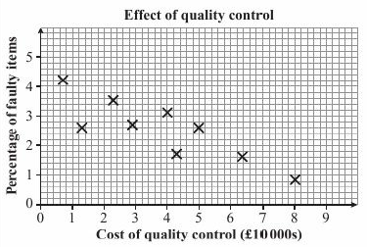
3.3 – Scatter Graphs
Page 72
9 – Exam-Style Questions
A manufacturer of mp3 players
monitors the cost of quality
control (in £ 10000s) and the
percentages of faulty items.
The results are shown on the
scatter graph.
State the type of correlation
between these variables
and interpret your answer,
What was the highest percentage of faulty items in the data set?
Find the range of the cost of quality control. (4 marks)
Exam hint
This graph is drawn on mm-squared paper so make sure you read off the values accurately. Be aware of the units when you give your answers.

Slide 51
3.4 – Line of Best Fit
Page 70
Objectives |  | Why Learn This
Draw a line of best fit on a scatter graph. Use the line of best fit to predict values. |  | You can use a line of best fit to predict someone's height from their shoe size.
Fluency
Copy and complete this sentence. When the correlation between x and y is negative, larger values of x are associated with __________ values of y.
ActiveLearn - Homework, practice and support: Higher 3.4

Slide 52
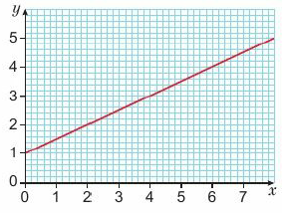
3.4 – Line of Best Fit
Page 73
Read the value of
  y when x = 6
  x when y = 2.5
Warm Up
Key Point 7
A Line of Best Fit is the line that passes as close as possible to the points on a scatter graph.

Slide 53
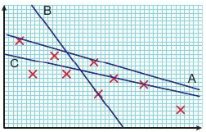
3.4 – Line of Best Fit
Page 73
Which line. A, B or C, is the best line of best fit for the data points on the scatter graph?

Slide 54
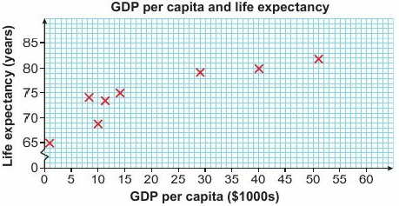
3.4 – Line of Best Fit
Page 73
Example 3
The scatter graph shows the GDP per capita (in $1000s) and life expectancy (in years) for eight countries.
Draw a line of best fit.
The GDP per capita in the UK is $36000. Estimate the life expectancy of a baby born in the UK.
Q5 communication hint - The gross domestic product (GDP) measures the value of goods and services produced by a country. The GDP per capita is the GDP divided by the number of people in that country.

Slide 55
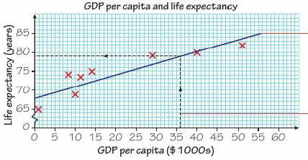
3.4 – Line of Best Fit
Page 73
Example 3
Estimated life expectancy in the
UK is 79 years.
Position a transparent ruler over your scatter graph so it follows the overall trend. Move it slightly so you have roughly the same number of points above and below the line.
To estimate the life expectancy, start at $36,000 on the horizontal axis, go up to the line of best fit and read off the answer on the vertical axis.

Slide 56
3.4 – Line of Best Fit
Page 74
The table shows the height and weight of eight athletes.
  Draw a scatter graph for this data.
  Draw a line of best fit on your graph,
  Use your line of best fit to estimate the weight of an athlete who is 185 cm tall,
  Estimate the height of an athlete who weighs 60 kg.
Height (cm) | 155 | 166 | 170 | 175 | 178 | 192 | 193 | 198
Weight (kg) | 50 | 65 | 64 | 77 | 67 | 85 | 115 | 95

Slide 57
3.4 – Line of Best Fit
Page 74
STEM A chemical engineer heats gas inside a sealed tank and measures the temperature (in degrees Kelvin, °K) and pressure (in atmospheres, atm).
Draw a line of best fit on a scatter graph and use the line to:
  estimate the temperature required to create a pressure of 2.8 atm
  estimate the pressure when the temperature is 308°K.
Temp (⁰K) | 300 | 330 | 304 | 312 | 325 | 339 | 342 | 351
Pressure (atm) | 1.4 | 1.5 | 1.7 | 2.0 | 2.2 | 2.3 | 2.5 | 3.0
Q4 hint - Draw lines on your scatter graph to show how you obtained your estimates.

Slide 58
3.4 – Line of Best Fit
Page 74
Real / Reasoning The table shows the height and shoe size of a group of male college students:
  Draw a line of best fit on a scatter graph and use it to estimate
    the shoe size of someone who is 175 cm tall
    the height of someone with shoe size 7
    the height of someone with shoe size 13.5.
  Which of these estimates do you think is the least reliable?
  Give a reason for your answer.
  Discussion As a general rule, is it better to use a line of best fit to make predictions about values inside or outside the existing range of data points?
Height (cm) | Shoe Size
158 | 4
168 | 5
164 | 6
167 | 8.5
174 | 8.5
178 | 10
173 | 10.5
185 | 12

Slide 59
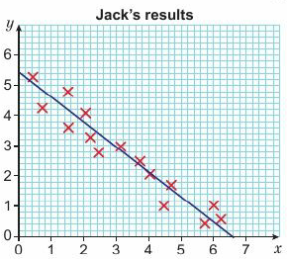
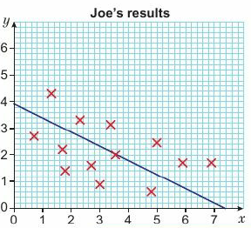
3.4 – Line of Best Fit
Page 74
Key Point 8
Using a line of best fit to predict data values within the range of the data given is called interpolation and is usually reasonably accurate.
Using a line of best fit to predict data values outside the range of the data given is called extrapolation and many not be accurate.
Real / Reasoning Jack and Joe perform an identical experiment in a science lesson. Their results are shown on the scatter graphs:
  Use the given lines of best fit to work out two estimates for the value of y at x = 3.
  Which of the estimates is likely to be more reliable? Give two reasons for your answer.
Q6b hint - The points on one diagram are very close to the line of best fit. On the other diagram the points are more scattered.

Slide 60
3.4 – Line of Best Fit
Page 75
Key Point 9
Individual points which are outside the overall pattern of a scatter graph are called outliers. If they are likely to be from incorrect readings you can ignore them.
STEM / Reasoning An elastic rope is suspended from the ceiling and stretched vertically by hanging weights on the end. The table shows the weight, W (in newtons), and length, L (in cm), of the elastic.
  Draw a scatter graph for this data,
  Why is the last point classified as an outlier? Suggest a
  possible reason for this,
  Draw a line of best fit passing close to the remaining eight points,
  Use the line to estimate the length of the elastic when a mass of 7 N is suspended,
  Estimate the length of the elastic when it is not stretched.
  Reflect A lot of the questions in this lesson ask you to estimate.
  Write a definition of the word 'estimate' in your own words.
Q7e hint - When the elastic is not stretched, no weight is suspended.
W (N) | 1 | 2 | 4 | 4.5 | 5 | 6.5 | 8.5 | 9 | 10
L (cm) | 12.4 | 14.8 | 18.6 | 20.4 | 21.2 | 24.5 | 29.4 | 30.4 | 40

Slide 61
3.4 – Line of Best Fit
Page 75
Key Point 9
Individual points which are outside the overall pattern of a scatter graph are called outliers. If they are likely to be from incorrect readings you can ignore them.
Modelling The table shows the age, x, and mass, y, of a sample of 11 boys.
  Draw a scatter graph of this data.
  Assuming that weight can be modelled using a line of best fit:
    estimate the weight of a 15-year-old
    estimate the weight of a 24-year-old.
  Which of the answers in part b is likely to be the more reliable?
  By drawing a smooth curve close to the data points, make new estimates of the weights in part b.
  Which of the two models is the more accurate? Give a reason for your answer.
x (years) | 2 | 4 | 6 | 8 | 10 | 12 | 14 | 16 | 18 | 20 | 22
Y (kg) | 13 | 16 | 21 | 25 | 33 | 40 | 51 | 60 | 67 | 71 | 72

Slide 62
3.4 – Line of Best Fit
Page 75
9 – Exam-Style Questions
The table shows the distance, d, of ten apartments from a city centre and the monthly rent, M, for each
Plot the points on a scatter graph.
Describe the relationship between the distance from the city centre and monthly rent.
Estimate the rent of an apartment that is 2.7 km from the city centre. (5 marks)
Distance, d (km) | 0.4 | 0.8 | 0.9 | 1.4 | 1.8 | 2.3 | 2.3 | 3.2 | 3.4 | 4
Rent, M (£) | 510 | 470 | 430 | 340 | 400 | 290 | 320 | 140 | 100 | 120
Exam hint
Always draw lines on your diagram for any readings from your graph. If you get the answer wrong, you may still get marks for using the correct method.

Slide 63
3.5 – Averages
Page 75
Objectives |  | Why Learn This
Decide which average is best for a set of data. Estimate the mean and range from a grouped frequency table. Find the modal class and the group containing the median. |  | You can compare aspects of your lifestyle with averages.
Fluency
Work out the range of 2, 6, 4, 9, 1 and 14.
ActiveLearn - Homework, practice and support: Higher 3.5

Slide 64
3.5 – Averages
Page 76
The table shows the scores when a dice is rolled.
  How many times is the dice rolled in total?
  What is the modal score?
a. Write down the number which is halfway between 11 and 20.
  What is the middle value in the interval 120 ≤ < 40?
Warm Up
Score | 1 | 2 | 3 | 4 | 5 | 6
Frequency | 4 | 1 | 3 | 3 | 2 | 1

Slide 65
3.5 – Averages
Page 76
Real / Finance The annual salaries of staff who work in a cake £12000, £12000, £15000, £18000, £40000
  Work out the mean, median and mode of staff salaries,
  The company wishes to quote one of the averages in an advertisement for new staff.
  Which of the averages would be the most appropriate?
  Give reasons for your answer.
Q3b hint - The number quoted in the advert must represent a typical salary that you could reasonably expect to earn.

Slide 66
3.5 – Averages
Page 76
Reasoning The sizes of shoes sold in a shop during a morning are 5, 5.5, 5.5, 6,7, 7, 7, 7, 8.5, 9, 9, 10, 11, 11.5, 12, 13
  Work out the mean, median and mode of these shoe sizes.
  The shop manager wishes to buy more stock but is only allowed to buy shoes of one size. Which one of these averages would be the most appropriate to use?
  Give reasons for your answer.
  Reflect What do you think the differences are between mean, median and mode?
  Write notes in your own words and include an example of when each would be appropriate to use.

Slide 67
3.5 – Averages
Page 76
Real / Finance
The monthly costs of heating a shop in the winter months are shown in the table,
  Work out the mean, median and mode of heating costs,
  The shop must provide a report of expenses and overheads to its accountant.
  Which of the averages is the most appropriate to
  provide in the
  report? Give
  reasons for
  your answer.
Month | Heating Cost
Nov | £180
Dec | £190
Jan | £270
Feb | £240
Mar | £180

Slide 68
3.5 – Averages
Page 76
Reasoning State whether it is better to use the mean, median or mode for these data sets. Give reasons for your answers.
  Time taken for five people to perform a task (in seconds): 6, 25, 26, 30, 30.
  Car colour: red, red, grey, black, black, black, blue.

Slide 69
3.5 – Averages
Page 76
Identify the outliers of the da ta sets and find the range of each.
  The masses of six members of a local wrestling team: 7 kg, 76 kg, 82 kg, 89 kg, 96 kg, 101 kg
  The salaries of the six people who work in a small restaurant: £14000, £15000, £15000, £17500, £19000, £38000
Q7a hint - Is it possible for someone in the team to weigh 7 kg?
Q7b hint - Who might be earning £38,000 in a restaurant? It is likely that this figure is correct.
Q7 strategy hint - Think about whether you should include the outlier in your calculations.

Slide 70

3.5 – Averages
Page 77
STEM / Finance Identify the outliers of the data sets. Calculate a sensible value of the range. Give a reason why the outlier has been included or excluded in your calculation,
  Nine temperature readings (in °C) recorded during a science experiment: 34, 44, 30, 27, 500, 30, 40, 45, 2.9
  The profit or loss made by a firm during the last six years: £100000, -£250000, £50000, £75000, £150000, -£25000
Q8b hint - The negative numbers indicate a loss.

Slide 71
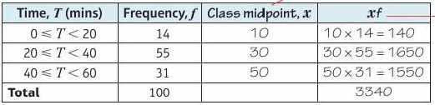

3.5 – Averages
Page 77
Example 3
The table shows the times, T, taken for 100 people
to queue for a rollercoaster at a theme park.
Estimate the mean waiting time.
Explain why the mean is only an estimate.
Mean = $\frac{sum of waiting times}{total number of people}$ = $\frac{3340}{100}$ = 33.4 minutes
The mean is an estimate because we don't know
the exact times taken.
Discussion What assumptions have been made about the data?
The third column gives an estimate of the waiting time in each class.
The fourth column gives an estimate of the total waiting time in each class.

Slide 72
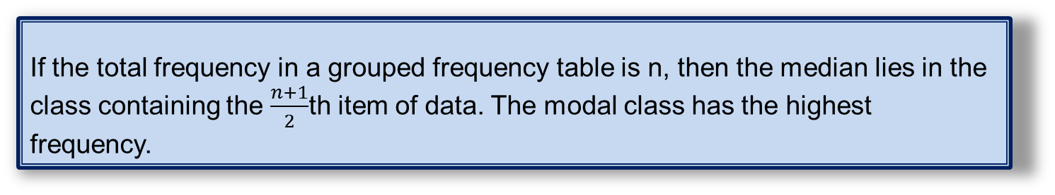
3.5 – Averages
Page 77
Real The grouped frequency table shows the length of Kate's
phone calls during the last month.
  Copy and complete the table to estimate the mean length of phone calls,
  A call costs 0.05 p/min. Estimate the total cost of these calls.
Time, T (mins) | Frequency, f | Midpoint, x | xf
0 ≤ T < 4 | 27 | 2 | 2 x 27 = 54
4 ≤ T < 10 | 34
10 ≤ T < 20 | 15
20 ≤ T < 60 | 4
Total
Key Point 10
If the total frequency in a grouped frequency table is n, then the median lies in the class containing the $\frac{n+1}{2}$th item of data. The modal class has the highest frequency.

Slide 73
3.5 – Averages
Page 77
Reasoning The times taken for students to do
their maths homework are shown in the table,
  How many students took less than 10 minutes to do their homework?
  How many students
  altogether took less than 20
  minutes to do their
  homework.
  How many students
  altogether took less than 30
  minutes to do their homework?
  State the modal class,
  Explain why the median is the 11th data value.
  Use your answers to parts a-d to work out which class interval contains the median.
t (mins) | Frequency
0 ≤ T < 10 | 3
10 ≤ T < 10 | 5
20 ≤ T < 20 | 8
30 ≤ T < 60 | 5

Slide 74

3.5 – Averages
Page 78
Real / Problem-solving The table shows the distances
jumped by two athletes training for a long jump event,
  How many jumps did Ben do in training?
  Explain why Ben's median distance is halfway between the 18th and 19th items in the data set.
  In which class interval is Ben's median?
  Work out which class interval contains Jamie's
  On average, which athlete jumps the furthest
  State the modal class for Ben and Jamie.
  At the long jump event,
  both athletes must compete
  against the current
  champion, who jumped
  8.31m.
  Who stands the better
  chance of beating him?
  Explain your answer.
t (mins) | Frequency | Jamie’s Frequency
6.5 ≤ d < 7.0 | 3
7.0 ≤ d < 7.5 | 7
7.5 ≤ d < 7.9 | 25
8.0 ≤ d < 8.5 | 1
8.5 ≤ d < 9.0 | 0

Slide 75
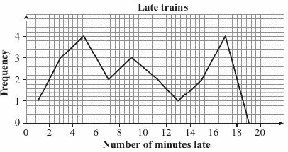
3.5 – Averages
Page 78
12 – Exam-Style Questions
A rail company monitors delays
on its peak time weekday service.
The results for the last month are
shown in the frequency polygon.
How many trains were more
than 14 minutes late last
month?
The company offers
compensation to its monthly season ticket holders if the mean delay on its peak weekday trains exceeds 10 minutes. Should the company offer compensation for last month? (5 marks)
Exam hint
Make sure you understand what the diagram represents before you begin.

Slide 76
3.6 – Statistical Diagrams 2
Page 78
Objectives |  | Why Learn This
Construct and use two-way tables. Choose appropriate diagrams to display data. Recognise misleading graphs. |  | Being able to recognise misleading graphs can help you to avoid being conned by misleading adverts.
Fluency
There are 670 boys in a school of 1200. How many girls are there?
ActiveLearn - Homework, practice and support: Higher 3.6

Slide 77
3.6 – Statistical Diagrams 2
Page 78
The table shows the drink choices of a group of 40 people.
Draw a pie chart to represent this data.
Draw a bar chart for the data in Q1.
Warm Up
Drink | Tea | Coffee | Cola | Water
Frequency | 4 | 1 | 3 | 3

Slide 78
3.6 – Statistical Diagrams 2
Page 79
A group of 180 students are asked whether they did their maths homework last night. The table shows some information about their responses.
Copy and complete the table.
 | Yes | No | Total
Boys |  | 30
Girls | 25 |  | 100
Total |  |  | 180
Q3 hint - Begin by using the total in the second row to work out the number of girls who did not do their homework.

Slide 79
3.6 – Statistical Diagrams 2
Page 79
Reasoning / STEM A clinical trial is carried out to compare the effect of two drugs for the treatment of hay fever.
One hundred hay fever sufferers were given either Drug A or Drug B. After a week the patients were asked to choose one of three responses: no change, improved or much improved.
  Copy and complete the table,
  What fraction of these patients were
  given Drug B?
  Which drug performed best in this trial?
  Give reasons for your answer.
 | No Change | Improved | Much improved | Total
Drug A
Drug B
Total
Q4b hint - Divide the number of patients given Drug B by the total number of patients.

Slide 80
3.6 – Statistical Diagrams 2
Page 79
Reasoning Students were asked whether they were in favour of having more lockers in the school changing rooms.
In Year 10,110 of the 180 students were in favour. In Year 11,100 of the 210 students were against the idea.
  Display this Information in a two-way table.
  The school will only buy new lockers if at least 60% of Year 10 and 11 students are in favour. Explain whether the school will buy the lockers.

Slide 81
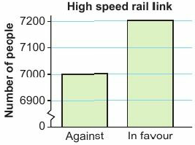
3.6 – Statistical Diagrams 2
Page 79
The bar chart shows the level of support for a new high speed rail link.
The government claims that this provides convincing evidence that people are in
favour of the
plans,
  Explain why this bar chart is misleading.
  Draw a correct version. Comment on what information this provides about the level of support for the new rail link.
Q6a hint - Look carefully at the vertical scale

Slide 82
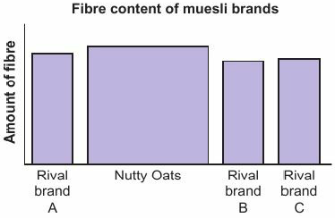
3.6 – Statistical Diagrams 2
Page 79
A supplier of 'Nutty Oats Muesli' claims that it provides more fibre than three rival brands and uses the bar chart to support this claim.
Give two reasons why this diagram is misleading.

Slide 83
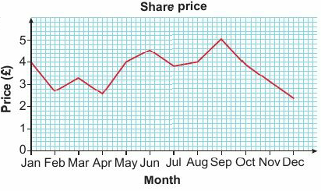
3.6 – Statistical Diagrams 2
Page 80
Finance / Reasoning The line graph shows the share
price of an ICT company on the first of each month,
  Find the share price on 1 May.
  Amelia bought 250 shares on
  1 February. She sold them on
  1 October. How much profit
  did she make?
  In which months should Amelia have bought and then sold her shares to make the highest profit?
Key Point 11
Line graphs are useful for tracking changes over time. Pie charts are good when comparing parts of a whole. Bar charts are used to compare the frequencies of two data sets.

Slide 84
3.6 – Statistical Diagrams 2
Page 80
Reasoning A tuck shop sells four types of crisps: ready salted (RS), cheese and onion (CO), salt and vinegar (SV), and smoky bacon (SB).
On one day, the shop sells these flavours to boys and girls:
Boys: CO, RS, CO, SV, SV, RS, RS, SB, CO, CO, RS, SB, RS, RS, CO, CO, RS, SV, SV, RS
Girls: RS, SB, SV, SV, CO, CO, RS, RS, RS, SV, RS, CO, SB, SV, SB, SV, SB, CO, SB, CO
  Explain why it is not possible to display this data on a frequency polygon,
  The shop manager decides to display the data on either a pie chart or a bar chart. Which should he use if he is most interested in:
    the proportion of each flavour bought by the boys or girls combined
    comparing the number of each flavour bought by boys and girls?
  The shop manager orders 720 packets of crisps from a supplier. How many packets of cheese and onion crisps should he order?

Slide 85
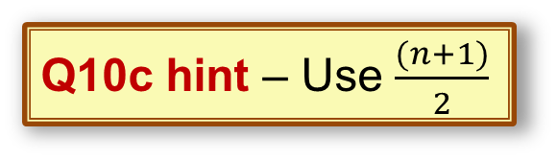
3.6 – Statistical Diagrams 2
Page 80
Communication A teacher records the marks awarded to boys and girls on a test.
Boys:23, 7, 10, 34, 10, 5, 3, 39, 31, 6, 7, 15, 21
Girls: 1, 15, 25, 39, 17, 24, 11, 28, 6, 39, 20, 16
  State one advantage of using a back-to-back stem and leaf diagram instead of a dual bar chart to display this information,
  Draw a back-to-back stem and leaf diagram for this data.
  Find the median marks to compare the performance of boys and girls on this test.
Q10c hint – What information do you
lose when you draw a bar chart?
Q10c hint – Use $\frac{(n+1)}{2}$

Slide 86
3.6 – Statistical Diagrams 2
Page 80
11 – Exam-Style Questions
A researcher wants to compare the waiting times at several hospital accident and emergency departments. The table shows the waiting times at one of the hospitals over a morning.
Which one of these statistical diagrams would be the best diagram to use to display this data?
stem and leaf pie chart frequency polygon scatter graph
b Give reasons for your choice. (4 marks)
Waiting time T (mins) | 0≤T<30 | 30≤T<60 | 60≤T<90 | 90≤T<120 | 120≤T<150 | 150≤T<180
Frequency | 20 | 35 | 30 | 24 | 15 | 12
Exam hint
Imagine trying to draw each diagram. You should also think about what the diagram is going to be used for

Slide 87
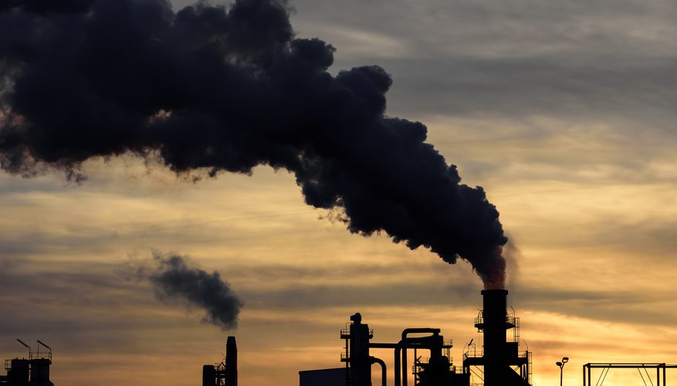
3 – Problem-solving: Pollution particulates
Page 81
Objectives
Be able to estimate the mean from a frequency polygon. Be able to construct a statistical argument and identify limitations arising from estimating the mean.
Air Pollution Limits
Fact
Companies are not allowed to cause too much air pollution.
This includes the number of airborne particulates they produce.
The legal limits for particulates are a yearly mean of
40 mg in every cubic metre of air for PM10 (coarse) particles
25 mg in every cubic metre of air for PM2.5 (fine) particles.
PM2.5 particles have a diameter of less than 2.5 micrometres.
PM10 particles have a diameters between 2.5 and 10 micrometres.
1 micrometer = 10⁻⁶ metres

Slide 88
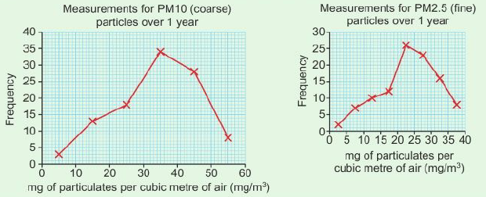
3 – Problem-solving: Pollution particulates
Page 81
Case Study
A national newspaper recently accused a company of being over the legal air pollution limits. The company tried to persuade the newspaper to withdraw the story by publishing two frequency polygons. According to the company, these frequency polygons showed that their yearly means for both types of particulates were below the legal limits.
The newspaper refused to withdraw the story. It claimed that the company's frequency polygons did not fully prove that levels of particulates fell
below the legal
limits.

Slide 89
3 – Problem-solving: Pollution particulates
Page 81
Case Study
Are the means in the case study above or below the legal limits for particulates?
Construct a statistical argument supporting the claims made by the newspaper. Is there evidence to support the claim that one of the yearly averages could be over the legal limit?
Q1 hint - Use the frequency polygons to produce two grouped frequency tables. From these tables you can estimate the mean for each type of particulate.
Q2 hint - Are your answers to Q1 exact means? What assumption are you making, and how does this work to the company's advantage? What would happen if the actual values were typically higher than the midpoint in some or all of the groups? Could you estimate a maximum value for the mean?

Slide 90
3 – Check up
Page 82
3. Check up
Log how you did on your Student Progression Chart
Statistical diagrams
Copy and complete the two-way table, which shows the voting intentions of a group of men and women.
  How many women are in the group?
  How many women intend to vote for Party A?
 | Party A | Party B | Total
Men | 120 |  | 200
Women
Total |  | 130 | 380

Slide 91
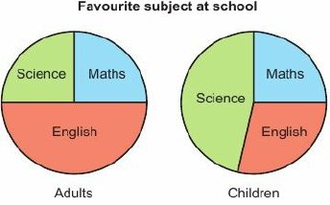
3 – Check up
Page 82
A group of 48 adults are asked what their favourite subject was at school. They can choose from maths, English and science.
A group of 32 school children are asked the same question.
The pie charts
show the
choices for
the adults
and children
separately,
  How many adults chose English?
  Reeshma says that an equal number of adults and children chose maths.
  Is she correct? Give a reason for your answer.

Slide 92
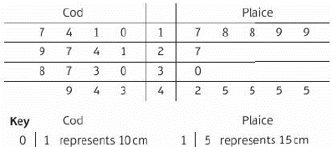
3 – Check up
Page 82
The lengths of cod and plaice caught by a fishing trawler are shown in the back-to-back stem and leaf diagram,
  How many cod did the trawler catch?
  Compare the ranges,
  Find the median length of plaice caught.
  Any fish caught that are under 22 cm in length must be returned to the sea. What is the total length offish returned?

Slide 93
3 – Check up
Page 82
Draw a frequency polygon for this data.
Time | 0≤T<20 | 20≤T<40 | 40≤T<60 | 60≤T<80 | 80≤T<100
Frequency | 6 | 5 | 1 | 2 | 5

Slide 94
3 – Check up
Page 82
Averages and range
Identify the outliers in the data sets and work out the range of each, including the outliers,
  Price of TVs: £450, £450, £640, £690, £4800
  Heights of plants in cm: 42, 47, 39, 51, 22, 24
For the grouped frequency table: a estimate the mean b state the group containing the median c estimate the range d state the modal class.
t (mins) | Frequency
0 ≤ d < 5 | 7
5 ≤ d < 10 | 15
10 ≤ d < 15 | 13
15 ≤ d < 20 | 4
20 ≤ d < 25 | 1

Slide 95
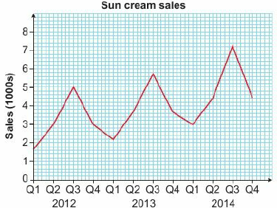
3 – Check up
Page 83
Scatter graphs and time series
Reasoning The time series graph shows the sales (in 1000s) of bottles of sun cream during the last three years.
  How many bottles were sold in the third quarter (Q3) of 2012?
  Give a possible reason why the sales fluctuate up and down,
  Describe the overall trend in sales over this three-year period.

Slide 96
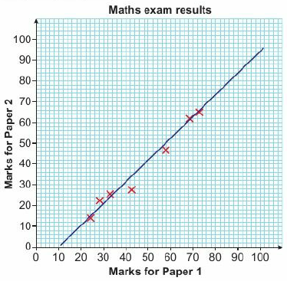
3 – Check up
Page 83
Reasoning The table shows the marks awarded to seven
candidates taking two maths exams. The information is
displayed in the scatter diagram together with a line of best fit.
  State whether this diagram shows
  positive, negative or no correlation.
  Use the line of best fit to estimate
  the mark that someone might get on:
      Paper 2 if they got 50 on Paper 1.
      Paper 1 if they got 90 on Paper 2.
  Which of your answers to part b
  would you expect to be more reliable?
  Give reasons for your answer.
Candidate | A | B | C | D | E | F | G
Marks for Paper 1 | 57 | 68 | 42 | 24 | 28 | 71 | 34
Marks for Paper 2 | 45 | 61 | 28 | 14 | 22 | 64 | 24

Slide 97
3 – Check up
Page 83
How sure are you of your answers? Were you mostly
Just guessing ☹ Feeling doubtful 😐 Confident ☺
What next? Use your results to decide whether to strengthen or extend your learning.
* Challenge
a. Write down any four numbers and calculate the mean.
  Add 3 to each number in your list and calculate the new mean,
  What do you notice about your answers to parts a and b?
  Use algebra to show that this works for any set of four numbers,
  What happens to the mean when each number is multiplied by c? Use algebra to show you are correct.

Slide 98
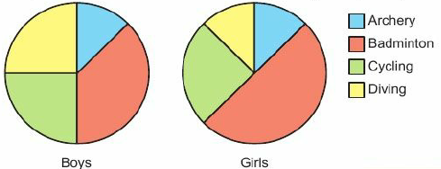
3 – Check up
Page 84
Statistical diagrams
A group of 40 boys and 72 girls are asked to choose their favourite Olympic sport from archery, badminton, cycling and diving.
The pie charts show
the choices for the
boys and girls
separately.
  How many girls chose badminton?
  How many boys chose cycling?
  Sam says that equal numbers of boys and girls chose archery. Is he correct? Give a reason for your answer.
Q1a hint - What fraction of the girls pie chart represents badminton?
Q1c hint - Work out the numbers for each pie chart and compare.

Slide 99
3 – Check up
Page 84
Statistical diagrams
Real A group of students are asked whether they study a science or arts subject at college.
The information is shown in the two-way table.
  How many of the students study a n arts subject?
  How many of the students are women studying science?
  What fraction of the
  group are men?
Q2a hint - The arts students are in the second column.
 | Science | Arts | Total
Men | 25 | 15 | 40
Women | 20 | 20 | 40
Total | 45 | 35 | 80
Q2b hint - Go along the row labelled 'Women' and down the column labelled 'Science'.
Q2c hint - The last column shows that there are 40 men and 80 students altogether.

Slide 100
3 – Check up
Page 84
Statistical diagrams
A group of 20 children are asked if they have a pet.
The information is shown in the two-way table.
  Work out the number of boys who have a pet.
  Workout the total number of boys,
  Workout the total number of girls,
  Fill in the remaining numbers in the table.
 | Yes | No | Total
Boys |  | 4
Girls | 3
Total | 5 |  | 20
Q3a hint - Fill in the number i n the top left-hand corner. The first column should add up to 5.
Q3c hint - Fill in the middle number in the last column. The column should add up to 20.
Q3b hint - Add up the two numbers in the top row.

Slide 101
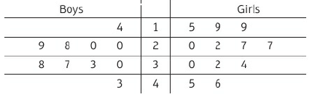

3 – Check up
Page 85
The times taken (in minutes) to complete a task by a group
of boys and girls are shown in the back-to-back stem and
leaf diagram.
  How many boys are there in the group?
  What is the shortest time for the boys?
  How many girls took longer than 40 minutes to complete the task?
  What is the longest time
  overall? Is this achieved by
  a boy or a girl?
Q4a hint - Try writing out the complete list for the boys. The 10s digit is in the middle column, so the longest time for the boys is 43 (not 34).
Q4c hint - The girls are on the right, so you read their times forwards. For exam pie, 15,19,19,... Write out the complete list for the girls.

Slide 102
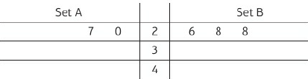

3 – Check up
Page 85
a. Copy and complete the back-to-back stem and leaf
diagram for the data sets.
A: 20, 27, 30, 30, 32, 38, 49
B: 26, 28, 28, 32, 33, 40
  For each data set find
    the median
    the range.
  Compare the two data sets.
Q5a hint - Begin with Set A. The first two numbers are 20 and 27. They have been written backwards on the first row. Do the same for the second row with the next four numbers.
Q5b i hint - The median is the middle value. If there are two middle values, the median is halfway between them.
Q5b ii hint - The range is the difference between the largest and smallest values.
Q5c hint - Write about the ranges and medians in your answer.

Slide 103

3 – Check up
Page 86
Real Twenty people record the time, t hours, they
spend on the internet during a day.
Time | 0 ≤ t < 2 | 2 ≤ t < 4 | 4 ≤ t < 6 | 6 ≤ t < 8 | 8 ≤ t < 10
Frequency | 1 | 3 | 9 | 5 | 2
Midpoint | 1 | 3
  Copy and complete the table to show the midpoints,
  Copy and complete the frequency polygon.
  Plot the midpoints on the horizontal axis and frequency on the vertical axis.

Slide 104

3 – Check up
Page 86
The frequency polygon shows the length (in
minutes) of 15 songs.
Midpoint | 0.5 | 1.5
Interval | 0 ≤ t < 1 | 1 ≤ t < 2
Frequency | 1 | 2
Q7 hint - The midpoints are the values shown on the horizontal axis on the graph. The frequencies are the values shown on the vertical axis on the graph.
Q7 hint - Check that the frequencies add up to 15.

Slide 105
3 – Check up
Page 86
Averages and range
Jason records the following lengths during a physics experiment.
3.4cm, 5.8 cm, 2.9cm, 4.8cm, 46cm, 5.8cm
  Which one of these values is an outlier?
  Explain why it is appropriate to remove this outlier from the data set.
  Calculate the range.
Q1a hint - Look at the list and find a value that is much bigger that the rest.
Q1b hint - Outliers can be removed if you think they are clear errors. What do you think Jason might have done here?
Q1c hint - Do not include the outlier value in your calculation.

Slide 106
3 – Check up
Page 87
STEM A zoologist measures the lengths of 50 snakes (to the nearest cm). On a copy of the table
complete the third column to show the midpoints of each class
complete the 4th column to find the total length of all the snakes
use your answer to part b to work out the
mean length...
Q2a hint - To find the mid point of 20 ≤ L <30, add the endpoints and divide by 2:
20 + 30 = 50
50 ÷ 2 = 25
Length (L cm) | Frequency | Midpoint | Frequency x Midpoint
0 ≤ x < 20 | 7 | 5 | 7 x 5 = 35
10 ≤ x < 20 | 12 | 15 | 12 x 15 = 180
20 ≤ x < 30 | 20
30 ≤ x < 40 | 8
40 ≤ x < 50 | 3
Total | 50
Q2c hint - Divide the total length by the total number of snakes.

Slide 107
3 – Check up
Page 87
Real A speed camera records the speeds of passing cars
during the morning rush hour.
How many cars were there altogether?
What percentage of cars broke the speed limit of 30 mph?
Copy and complete the table to work out the mean speed..
Speed (x mph) | Frequency | Midpoint | Frequency x Midpoint
0 ≤ x < 20 | 8 | 10 | 8 x 10 = 80
10 ≤ x < 25 | 90
25 ≤ x < 30 | 184
30 ≤ x < 40 | 18
Total
Q3a hint - Find the total of the frequency column.
Q3a hint - Divide the number of cars in the 30 ≤ x < 40 class by the total number of cars and multiply by 100.
Q3c hint - Follow the method you used in Q2.

Slide 108

3 – Check up
Page 87
Scatter graphs and time series
State whether each scatter graph indicates positive, negative or zero correlation..
Q1 hint - Do the points lie close to a line? If not, there is zero correlation. An uphill line shows positive correlation and a downhill line shows negative correlation.

Slide 109

3 – Check up
Page 88
Scatter graphs and time series
STEM In a science experiment a ball is dropped onto the ground five times to see if there is a connection between the height of the drop and the height of the bounce.
  Copy and complete the scatter graph.
  Copy and complete
  the sentence. As the
  height of the drop
  increases, the height of
  the bounce …
Drop (cm) | 50 | 75 | 100 | 150 | 200
Bounce (cm) | 24 | 38 | 42 | 80 | 92
Q2a hint - Height of drop is plotted on the horizontal axis and height of bounce is plotted on the vertical axis. The vertical axis goes up by 4 units for each small square.

Slide 110
3 – Check up
Page 88
Scatter graphs and time series
  Does the scatter graph show positive, negative or zero correlation?
  Draw a line on your diagram that passes as close as possible to the five points,
  Use the line of best fit to predict the height of bounce when the ball is dropped from a
  height of 125cm.
Q2c hint - As you look at the diagram from left to right, do the points slope upwards, downwards or neither?
Q2d hint - Use a transparent ruler and try to draw the line so you have two or three points above the line and a similar number below.
Q2e hint - Start at 125cm on the horizontal axis. Draw a vertical line up until you hit the line of best fit. Now draw a horizontal line from that point across to the vertical axis and read off the answer.

Slide 111

3 – Check up
Page 88
  Real A company reviews its pricing policy by monitoring monthly sales (in thousands of items) and prices.
    Copy and complete the scatter graph.
    One of the points on the graph
    is an outlier and should be ignored. Which point is it?
Price (£) | 32 | 30 | 25 | 15 | 12 | 8 | 5
Sales (1000s) | 12 | 60 | 16 | 30 | 37 | 41 | 44
Q3a hint – Each small square on the horizontal axis is worth one unit.

Slide 112
3 – Check up
Page 88
    Describe the relationship between sales and price.
    Draw a line of best fit on your diagram.
    Use the line of best fit to estimate £ monthly sales when the price is '
        £20 ii. £36
Q3c hint - State the correlation and write a sentence that begins, 'As price increases, sales...'.
Q3d hint - Ignore the outlier when drawing your line.
Q3e hint – Follow the method you used in Q2.
Q3e hint – Interpolation (predicting values with in the range of points on your graph) is reliable but extrapolation (predicting values outside the range of points on your graph) is unreliable.

Slide 113
3 – Check up
Page 88
    Which of your answers is the most reliable in
    part e?
    Give a reason for your answer.
    Use the line of best fit to find the price needed to get monthly sales figures of 20000.
Q3f hint – Interpolation (predicting values with in the range of points on your graph) is reliable but extrapolation (predicting values outside the range of points on your graph) is unreliable.
Q3g hint – Start with the sales on the vertical axis, go along to the line and read off the price on the horizontal axis. Always draw the lines on your diagram.

Slide 114

3 – Check up
Page 89
    Reasoning The table shows the number of
    ice lollies sold by a kiosk at a seaside resort last year.
Month | Jan | Feb | Mar | Apr | May | Jun | Jul | Aug | Sep | Oct | Nov | Dec
Number | 10 | 80 | 150 | 220 | 290 | 360 | 360 | 290 | 220 | 150
Q4c hint – Read the numbers in the table from left to right to spot the pattern.

Slide 115

3 – Extend
Page 89
    Reasoning Each point on the scatter graph shows the mass of a bag of fertiliser and its price.
      Which two bags are the same price?
      Which of B and D gives the better value for money?
      Which two bags give the same value for money?
      Which bag gives the worst value for money?
      Describe the
      correlation.
      Give reasons
      for your
      answers.

Slide 116
3 – Extend
Page 89
    Reasoning There is positive correlation between variables x and y, negative correlation between y and z and negative correlation between z and w.
    State what type of correlation you would expect between
      x and z b. y and w
      x and w.
    Reasoning Find the value of the missing number, a;, in this list: 2, 4, 5, 5, 6, 7, 7, x
      if the mode is 7 b. if the mean is 6.
Q2 strategy hint - You could draw diagrams to help you.

Slide 117

3 – Extend
Page 90
    STEM / Problem-solving Two dozen tomato plants are grown in a greenhouse and the total weight of fruit produced by each plant is recorded. The same number of tomato plants of this variety is grown outdoors. The information is displayed in the frequency polygons.
      Estimate the greatest mass of tomatoes grown by a plant outdoors,
      How many plants grown In the greenhouse produce between 4 kg and 6 kg of fruit?
      The grower claims that the average yield of plants grown in the greenhouse exceeds the average yield of outdoor plants by more than 3 kg. Does this data support the claim?
Q5 communication hint - Yield means the amount of fruit produced.

Slide 118
3 – Extend
Page 90
    Reasoning A group of 50 students take a maths test. Their marks out of 40 are shown in the table.
      Estimate the mean mark and explain why this is only an estimate,
      Explain which class contains the median,
      Estimate the range.
      The student whose mark was between 20 and 22 has her paper remarked. She is awarded a new mark between 23 and 25.
      Without doing any calculations, state whether the following will increase, decrease or stay the same.
        Range ii. Mean
Marks | 20-22 | 23-35 | 26-30 | 31-40
Frequency | 1 | 15 | 22 | 12

Slide 119

3 – Extend
Page 90
    Reasoning Every student in Year 10 completes a questionnaire in which they are asked to choose their favourite takeaway food from pizza, burger and curry.
    The results are shown on the pie chart,
      If 132 students chose pizza, how many chose burger?
      On a similar pie chart for Year 11, the angle of the sector for pizza is 200°.
      Explain why this
      does not
      necessarily mean
      that fewer
      students in Year
      11 chose pizza
      as their favourite.

Slide 120


3 – Extend
Page 91
    Reasoning The stem and leaf diagram shows the ages in complete years of a sample of 24 men in a tennis club,
      Find the median age.
      The ages, in complete years, of a sample of 14 women from the club are: 82, 58,53,9, 23, 81, 45, 48, 31, 77, 16, 23, 64, 62
      Draw a back-to-back stem and leaf diagram for the men's and women's ages,
      Without doing any further calculations, make one comparison between the ages of men and women at the club.
Q3 hint – Look at the outline shapes of the two sides of the diagram.

Slide 121
3 – Extend
Page 91
8 – Exam-Style Questions
Suzy did an experiment to study the times, in minutes, it took
1 cm ice cubes to melt at different temperatures.
Some information about her results is given in the scatter graph.
The table shows information from two more experiments.
On the scatter graph, plot the information from the table.
(1mark)
Describe the relationship between the temperature and the time it takes a 1 cm ice cube to melt. (1 mark)
Find an estimate for the time it takes a 1 cm ice cube to melt when the temperature is 25 °C. (2 marks)
Suzy’s data cannot be used to predict how long it will take a I cm ice cube to melt when the temperature is 100 °C.
Explain why. (1 mark)
Nov 2011, Q11, 1380/3H J

Slide 122

3 – Extend
Page 91
8 – Exam-Style Questions
Exam hint
Draw a line of best fit on the graph to help you answer part e.
Temperature (⁰C | 15 | 55
Time (Minutes) | 22 | 15

Slide 123


3 – Extend
Page 91
Key Point 12
line of best fit passes through the mean point,($\overline{x}$, $\overline{y}$), where $\overline{x}$ is the mean of the x coordinates and $\overline{y}$ is the mean of the y coordinates.
Age (years) | 1 | 2 | 3 | 6 | 7
Price (£1000s) | 25 | 18 | 15 | 9 | 6
    Real / Problem-solving A car showroom has five cars, all of the same model but of different ages. The table shows the age, x (in years), and the price, y (in £1000s) of each car.
      Plot the points on a scatter graph and state the type of correlation,
      Find the mean, $\overline{x}$, of the ages of the cars.
      Find the mean, $\overline{y}$, of the values of the cars,
      Plot the point ($\overline{x}$. $\overline{y}$) on your scatter diagram and draw a line of best fit passing through this point.
      Use your line to estimate the cost of a car that is 5 years old.
      Explain why it would not be sensible to use the line to
      estimate the value of a new car of this model.at the club.

Slide 124
3 – Extend
Page 92
    Modelling The table shows the age and mass of a
    group of 10 people
    .
      Plot these points on a scatter graph.
      Draw a line of best fit on the diagram passing through the mean point and with roughly the same number of points above and below the line,
      Use your line to estimate the mass of someone who is 23 years old.
      A better model is to use two different straight lines, one up to 20 years old and the other for over 20. Draw these on your diagram and use them to obtain a more reliable answer to part c.
Age | 84 | 8 | 12 | 13 | 15 | 30 | 40 | 45 | 52 | 55
Mass (kg) | 18 | 30 | 45 | 49 | 57 | 76 | 79 | 81 | 9 | 6

Slide 125
3 – Extend
Page 92
    Real / Problem-solving The table shows the age distribution of male and female teachers in a school.
      Draw frequency polygons for these two sets of data on the same diagram,
      By calculating the mean of each data set, compare the age distributions of male and female teachers.
      What feature of your diagram confirms that your comparison is correct?
Age (x years) | Male | Female
20 ≤ x < 25 | 1 | 0
25 ≤ x < 30 | 2 | 9
30 ≤ x < 35 | 3 | 10
35 ≤ x < 40 | 7 | 12
40 ≤ x < 45 | 10 | 8
45 ≤ x < 50 | 10 | 7
50 ≤ x < 55 | 12 | 4
55 ≤ x < 60 | 4 | 0
60 ≤ x < 65 | 1 | 0

Slide 126
3 – Extend
Page 92
    Finance The table shows the annual salaries of 200 employees of a company.
      Copy and complete the table,
      What percentage of
      employees are women?
      What percentage of men
      earn under £30000?
      What percentage of employees
      earning at least £30000 are women?
    Reasoning Every student in Year 7 must
    attend a lunchtime club. They can choose
    from music, drama or sport.
    Out of the 185 students in Year 7,
    65 choose music and 49 choose
    drama. Of the 95 boys in the
    year, 35 choose music. 32 girls choose sport.
    Copy and complete the two-way table for this information.
 | Under £30000 | At least £30000 | Total
Men | 60 |  | 90
Women |  | 50
Total |  |  | 200
 | Music | Drama | Sport | Total
Boys
Girls
Total

Slide 127
3 – Extend
Page 92
    Reasoning One hundred students studying music at school are asked to choose their preference from rap, jazz and classical.
    Of the 29 who choose rap, 13 are girls. Of the 21 who choose jazz, 10 are girls.
    There are 54 boys altogether.
      Draw a two-way table and use it to work out the percentage of students who
        prefer classical music
        are girls who prefer classical music,
      What percentage of boys prefer rap?

Slide 128
3 – Extend
Page 93
    Problem-solving A car manufacturer compares colour preferences of men and women. Potential customers are asked to pick their favourite colour from a list of four. The results are shown in the table.
    Which one of these statistical
    diagrams could be used?
    Reflect For each of the statistical diagrams in this question, write down an example of when it would be the appropriate diagram to use.
Colour | Creamy white | Platinum Grey | Midnight blue | Charcoal Black
Men | 2 | 13 | 25 | 20
Women | 4 | 8 | 6 | 2
scatter graph frequency polygon
back-to-back stem and leaf diagram pie chart
Key Point 13
Means of time series data from several consecutive periods are called moving averages. These smooth out the ups and downs, enabling you to spot the trend.

Slide 129
3 – Extend
Page 93
    Real / Reasoning A retail company recorded the number of customer complaints each month.
    Draw a time series graph for this data.
    Show that the mean number of complaints
    during the first 3 months is 33.3 (1 d.p.)
    Show that the mean number of complaints for months 3, 3, and 4 is 31.7 (1 d.p.)
    Copy and complete the table for 3-month moving averages.
    What do these averages tell you about the overall trend in customer complaints.
Month | 1 | 2 | 3 | 4 | 5 | 6 | 7
Complaints | 45 | 35 | 20 | 40 | 30 | 15 | 30
Q16d hint – To find the moving average for months 3-5, add the values for months 3, 4 and 5 and divide by 3.
Q16e hint – You can plot the moving averages on tour time series graph. Make sure you plot each value in the middle of the 3 months it covers.
Month | 1-3 | 2-4 | 3-5 | 4-6 | 5-7
Moving Averages (1 d.p.) | 33.3 | 31.7

Slide 130
3 – Extend
Page 93
17 – Exam-Style Questions
A garage sells used cars. The table shows the number of used cars it sold from July to December.
Work out the 3-point moving averages for the information in the table. The first two have been worked out for you.
29 35 .................................. (2 marks)
Comment on the trend shown by the 3-point moving averages. (1 mark)
Nov 2011,
Q15, 1380/4H
July | August | September | October | November | December
28 | 25 | 34 | 46 | 28 | 40
Exam hint
Make sure your comment is in context by relating it to the number of cars sold.

Slide 131

3 – Knowledge Check
Page 94
3. Knowledge Check
A back-to-back stem and leaf diagram compares two sets of results. On the left-hand side the numbers are read backwards. A frequency polygon is a graph made by joining the midpoints of the tops of the bars in a bar chart with straight lines. A quicker way of drawing a frequency polygon is to plot the frequency against midpoints of each group. The modal class (or modal group) has the highest frequency. To estimate a mean from a grouped frequency table, add together the products of class midpoints and their frequencies, and divide by the total frequency. If the total frequency in a grouped frequency table is n, then the median lies in the group containing the $\frac{n+1}{2}$th item of data A time series graph is a line graph with time plotted on the horizontal axis.
Mastery
Lesson 3.1
Mastery
Lesson 3.1
Mastery
Lesson 3.2
Mastery
Lesson 3.5
Mastery
Lesson 3.5
Mastery
Lesson 3.5
Mastery Lesson 3.3

Slide 132
3 – Knowledge Check
Page 94
3. Knowledge Check
Bivariate data is data that has two variables. Points can be plotted on a scatter diagram to see if there is a link between them. Data displays positive correlation if the points on a scatter diagram lie close to an upward-sloping straight line. Data displays negative correlation if the points on a scatter diagram lie close to a downward-sloping straight line. A line of best fit is the line that passes as close as possible to the points on a scatter graph. Using a line of best fit to predict data values within the range of the data given is called interpolation and is usually reasonably accurate. Using a line of best fit to predict data values outside the range of the data given is called extrapolation and may not be accu rate. Individual points which are outside the overall pattern of a scatter diagram are called outliers. They can be removed fro a data set provided a reason for their removal is given.
Mastery
Lesson 3.4
Mastery
Lesson 3.3
Mastery
Lesson 3.4
Mastery
Lesson 3.4
Mastery
Lesson 3.4
Mastery Lesson 3.5

Slide 133

3 – Knowledge Check
Page 94
3. Knowledge Check
The line of best fit passes through the mean point, ($\overline{x}$. $\overline{y}$) Means of time series data from several consecutive periods are called moving averages. Look back at the questions you answered in this test, Which one are you most confident that you have answered correctly? What makes you feel confident? Which one are you least confident that you have answered correctly? What makes you feel least confident? Discuss the question you feel least confident about with a classmate. How does discussing it make you feel?
Extend 3
Extend 3
Reflect

Slide 134
3 – Unit Test
Page 94
3 Unit Test | Log how you did oil your Student Progression
    Reasoning To get a grade 9 in a GCSE exam, Bhavik must have a mean of at least 93%, averaged over three exam papers.
    His mean score on the first two papers is 89%. Is it still possible for him to achieve a top grade overall?
ActiveLearn - Homework, practice and support: Higher 3 Unit test

Slide 135

3 – Unit Test
Page 95
    Reasoning The time series graph shows the rate of unemployment in a country over a 3-year period,
      What was the rate of unemployment in the second quarter of 2014?
      Give your answer correct to 1 d.p. (1 mark)
      Which quarter experienced the greatest fall in the rate of unemployment? (1 mark)
      Describe what this
      time series suggests
      about the trend in
      unemployment over
      the 3 years. (1 mark)

Slide 136


3 – Unit Test
Page 95
    The back-to-back stem and leaf diagram shows the number of apples growing on two types of apple tree in an orchard.
      How many 'Autumn Gold‘ trees are there? (1 mark)
      Find the range of the number of apples growing on 'Ruby Red' trees. (1 mark)
      Find the median number of apples growing on 'Autumn Gold' trees. (1 mark)

Slide 137
3 – Unit Test
Page 95
    Reasoning The table shows the time that 80 customers spent queuing in a bank.
      Estimate the mean queuing time. (3 marks)
      In which group is the median time? (1 mark)
      It is discovered that one of the customers whose time was originally recorded as 9 minutes only queued for 3 minutes.
      Without doing any calculations, state whether your answers to parts a and b will increase, decrease or stay the same. (2 marks)
Time (t minutes) | Frequency
0 ≤ t < 2 | 18
2 ≤ t < 4 | 24
4 ≤ t < 6 | 20
6 ≤ t < 8 | 10
8 ≤ t < 10 | 6
10 ≤ t < 12 | 2

Slide 138
3 – Unit Test
Page 95
    The table shows the number of hours six students
    spent revising for a maths test and their mark.
      Plot this data on a scatter diagram. (3 marks)
      Describe the correlation and explain what this means in this context. (2 marks)
      Draw a line of best fit on your diagram and use it to estimate the mark of someone who revises for 3 hours.
      (2 marks)
      Is it sensible to use the graph to estimate someone's mark if they have done no revision at all? Give a reason for your answer. (1 mark)
Time | 5 | 2 | 8 | 1 | 6 | 4
Mark | 80% | 50% | 90% | 40% | 75% | 60%

Slide 139
3 – Unit Test
Page 96
    Reasoning An estate agent keeps a record of the types of property sold in the last month.
      Explain why it is not possible to present this information using a frequency polygon. (1 mark)
      Draw a pie chart for this data. (3 marks)
      Next month's sales are also displayed on a pie chart. The angle for the sector representing flats is 140°. Explain whether this shows that she has sold more flats than last month. (1 mark)
semi-detached terraced terraced flat detached detached flat terraced flat flat semi-detached flat detached terraced detached detached terraced flat flat terraced

Slide 140
3 – Unit Test
Page 96
    Reasoning 100 people each bought an electronic tablet with a choice of 16GB, 32GB or 64 GB of memory.
    53 of the customers are women. 12 of the women bought a 16 GB tablet.
    15 of the men bought a 32GB tablet. 20 of the 40 customers who bought a 64GB tablet are men.
      Draw a two-way table for this data. (3 marks)
      What fraction of customers bought a 32 GB tablet? (1 mark)

Slide 141

3 – Unit Test
Page 96
    The frequency polygon shows the distribution of times
    taken to clean a car.
      How many cars are cleaned in total?
      How many cars took between 40 and 50 minutes to be cleaned?
      State the modal class.

Slide 142

3 – Unit Test
Page 96
    Sample student answers
    Who has got the answer correct?
    Who gets the most marks? Explain why.
Exam-Style Question
Ed has 4 cards.
There is a number
on each card.
The mean of the 4 numbers on Ed’s cards is 10. Work out the number on the 4th card. (3 marks)
Student A Student B
7 $\frac{12 + 6 + 15 + ?}{4}$=10
33 + ? = 40
4th card = 6
12
6
15
?
June 2013, Q6, 1MA0/1H

